Slide 1


Topic Taxonomy
By : Charu Girdhar

Slide 2
Vitals
Organization Entity: NETFLIX
Web crawl Source: Webhose.io
Site Type : News
Date Range: February 2019 and march 2019

Slide 3
Deduplication
Original Dataset count : 10 k Articles each
Methods for deduplication :
Simhash with Distance = 25
Word2vec with google news models with score >0.7
Final deduplicated set: 5049 for Feb., 6324 for March

Slide 4
Named Entity Recognition Using Google NL - API
Entity | Count
One | 183
Two | 44
One Hundred | 30
Five | 28
Three | 26
News | 20
Deal | 20
Season | 19
Series | 17
Movie | 15
Viewers | 13
Four | 13
Chief Marketing Officer | 12
Nine | 11
Sales | 10

Slide 5
Named Entity Recognition Using Watson NLU - API
Entity | Count
Netflix | 1308
Ben Affleck | 63
Amazon | 60
Google | 35
Marie Kondo | 19
David Attenborough | 18
Lana Condor | 15
Olivia Colman | 14
AT&T | 12
Karamo Brown | 12

Slide 6
Topic Clustering
LDA using SKLearn – March dataset
max_df=0.5, min_df=30, max_features=500, max_iter=100
Topic #0: review | watch | high | bird | fly | black |triple frontier | frontier | ben affleck
Topic #1: netflix | film | fyre | festival | series | Academy| last | black | return
Topic #2: star | get | day | release | valentine | date | say | set | free | first
Topic #3: tv | 2019 | stream | best | 2019 | 5 | february | sex | service | movies
Topic #4: marie | kondo | take | award | roma | win | tidy | things
Topic #5: doll | russian | velvet | buzzsaw | release | date | cast | time
Topic #6: show | make | movie | disney | variety | variety | hulu | launch | back | new
Topic #7: news | apple | video | deal | series | game | stock | come |tech
Topic #8: apple | netflix | movie | box | bird | bird box | app | footage | academy | apple
Topic #9: stream | service | new | eye | queer | queer eye | stream service | | life | house

Slide 7
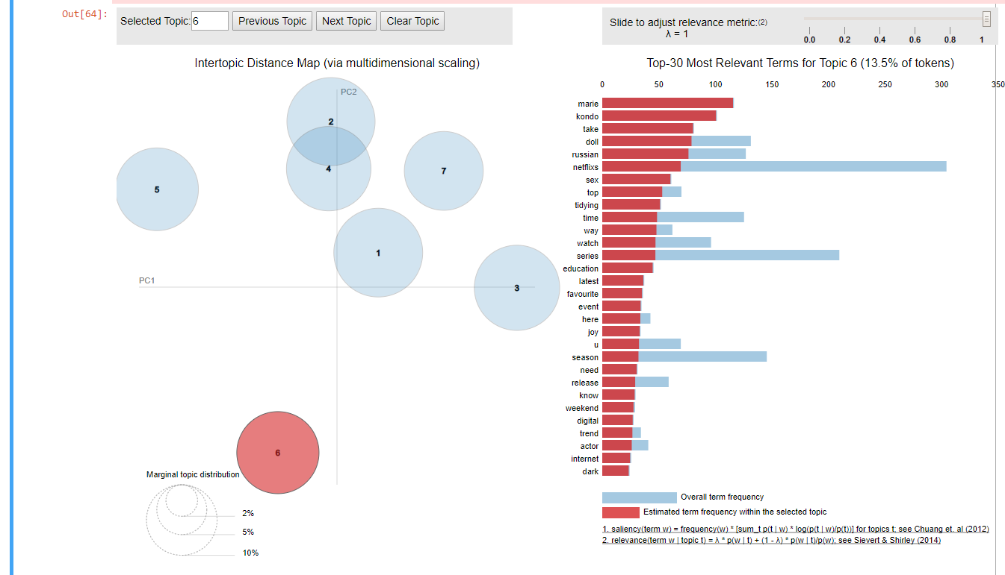
LDA Using Gensim:
Feb Data
no_below=10
no_above=0.8

Slide 8
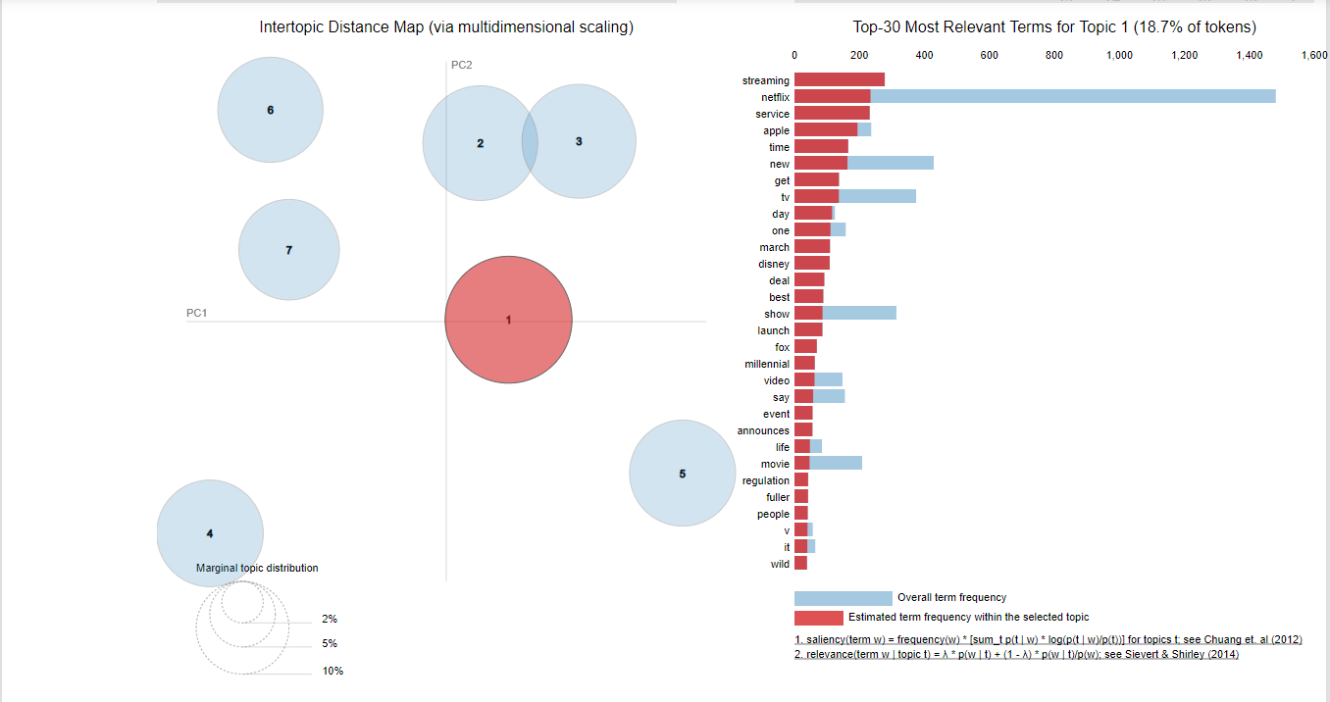
LDA Using Gensim:
March Data
no_below=15
no_above=0.8

Slide 9
Final Topic Clusters
topic taxonomy = {
"Netflix content":
{
"New Releases": "February Valentine Trailer Release Premiere",
"Netflix Originals": "Original Series Movie Premier Animated Documentary Comedy Killer"
},
"Netflix Achievements":
{
"Accolades and Awards": "Festival Best Bafta Academy Win Oscar February Hollywood"
},
"Netflix stocks":
{
"Stock Market": "Deal Stock Market Million"
},
"Competition":
{
"Other Streaming Services": "Apple Service HULU Disney Amazon Streaming Launch"
},
"Popular Shows":
{
"Marie Kondo ": "Marie Kondo Tidying Joy Favorite",
"Velvet Buzzsaw": "Buzzsaw Velvet Umbrella",
“Madeleine McCann": "Queer Eye Madeleine McCann documentary "
}
}

Slide 10
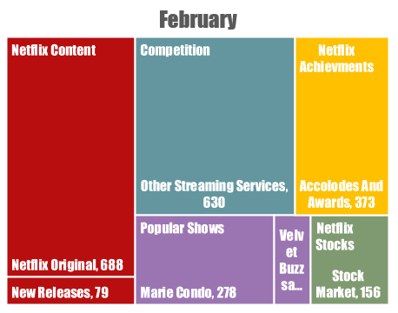
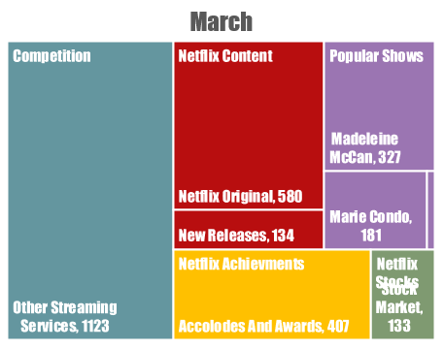
Predominant Topic labels for Netflix
Top 3:
Other Streaming Services
Netflix Original
Accolades and Awards

Slide 11
Stocks Plot for 2 months

Slide 12
Thank You!

